Slide 1

End-to-End E-Commerce
Data Science Analysis and Machine Learning on Flipkart
Product Data
GOKUL KARTHIKEYAN R
AUGUST - 2025
27-02-2026

Slide 2
Project Overview
This capstone project focuses on analyzing real-world
e-commerce product data scraped from the Flipkart website. The objective is to understand product trends, customer preferences, and performance patterns using data science techniques. The project covers the complete data science lifecycle, including data collection, cleaning, storage, exploratory analysis, unsupervised learning, supervised learning, and hyperparameter tuning to derive actionable business insights.
Notes:
Notes to presenter:
What is your purpose for sharing this reflection?
Is it at the end of a unit or project?
Are you sharing this reflection, at the attainment of a learning goal you set for yourself?
Is it at the end of a course?
State your purpose for the reflection or even the purpose of the learning experience or learning goal. Be clear and be specific in stating your purpose.

Slide 3
Problem Statement
Flipkart provides extensive product data, but it is available in raw and unstructured form, making analysis challenging. This project scrapes and structures Flipkart product data and applies machine learning to uncover trends, classify products, and support data-driven product and marketing decisions.
Notes:
Notes to presenter:
Description of what you learned in your own words on one side.
Include information about the topic
Details about the topic will also be helpful here.
Tell the story of your learning experience. Just like a story there should always be a beginning, middle and an end.
On the other side, you can add a graphic that provides evidence of what you learned.
Feel free to use more than one slide to reflect upon your process. It also helps to add some video of your process.

Slide 4
Data Collection Web Scraping
Source:
Flipkart E-Commerce Website
Tools & Technologies
  Python
  BeautifulSoup / Requests
  Pandas
Data Scraped
  Product Name
  Price
  Category
  Ratings
  Number of Reviews
The data was scraped ethically while respecting website structure and usage policies, and stored in CSV format for further processing.
Notes:
Notes to presenter:
What did you think at first?
What obstacles did you encounter along the way?
How did you overcome those obstacles?
What images can you add to support your process?
This SmartArt allows you add images and text to help outline your process. If a picture is worth a thousand words, then pictures and words should help you communicate this reflection on learning perfectly! You can always click on Insert>SmartArt to change this graphic or select the graphic and click on the Design contextual menu to change the colors.
Feel free to use more than one slide to reflect upon your process. It also helps to add some video of your process.

Slide 5
Data Cleaning & Preprocessing
After loading the scraped data into a Pandas DataFrame, the following steps were performed:
  Handled missing values and inconsistent records
  Removed duplicate and irrelevant entries
  Standardized currency symbols and numerical formats
  Converted text data to consistent casing
Notes:
Notes to presenter:
What was important about this learning experience?
How is it relevant to your course, yourself, or your society or community?
Why is this significant?
This SmartArt allows you add images and text to help outline your process. If a picture is worth a thousand words, then pictures and words should help you communicate this reflection on learning perfectly! You can always click on Insert>SmartArt to change this graphic or select the graphic and click on the Design contextual menu to change the colors.

Slide 6
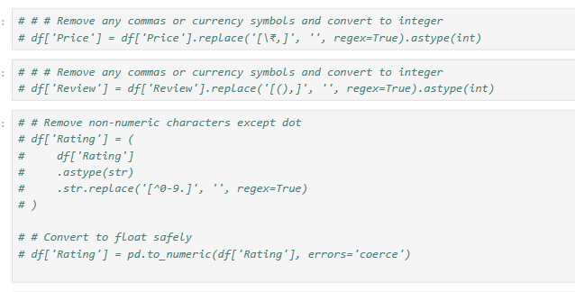
Data Cleaning
Notes:
Notes to presenter:
What steps will you be taking as a result of this learning experience?
Did you learn from any failed experiences? How will you do things differently?
What advice will you give to others so they can learn from your experiences?
How can you share what you learned with a real-world audience?
Some examples of next steps might be:
After delivering my first persuasive presentation, I am thinking about joining the debate team.
After making my first film, I’m considering entering it in our school film festival or local film festival.
After connecting with this career expert, I’d like to do some research on that career field because it sounds interesting to me.
This SmartArt allows you add images and text to help outline your process. If a picture is worth a thousand words, then pictures and words should help you communicate this reflection on learning perfectly! You can always click on Insert>SmartArt to change this graphic or select the graphic and click on the Design contextual menu to change the colors.
Feel free to use more than one slide to share your next steps. It also helps to add some video content to explain your message.

Slide 7
Exloratory Data Analysis(EDA)
  Performed Exploratory Data Analysis (EDA) to study:
    Price distribution
    Rating trends
    Category-wise product distribution
    Review count patterns
EDA helped identify outliers, popular categories, and highly rated products.

Slide 8
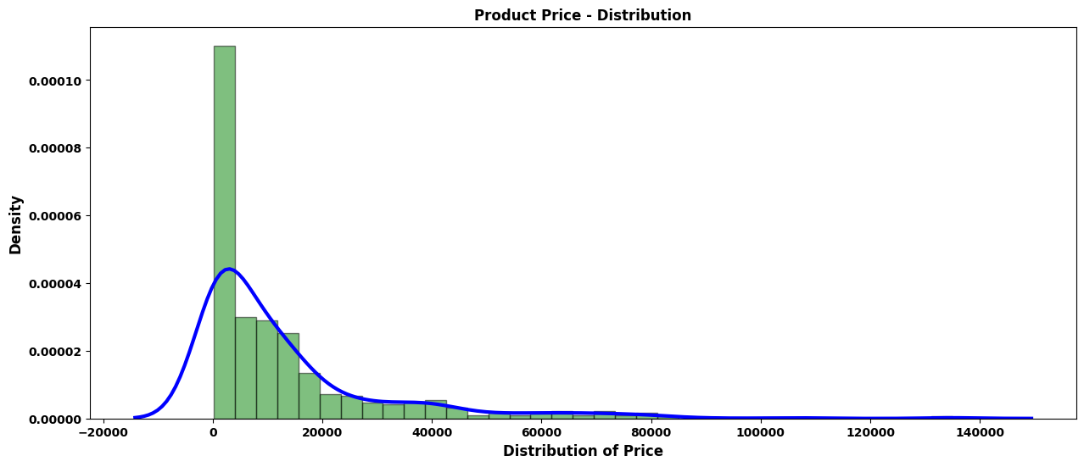
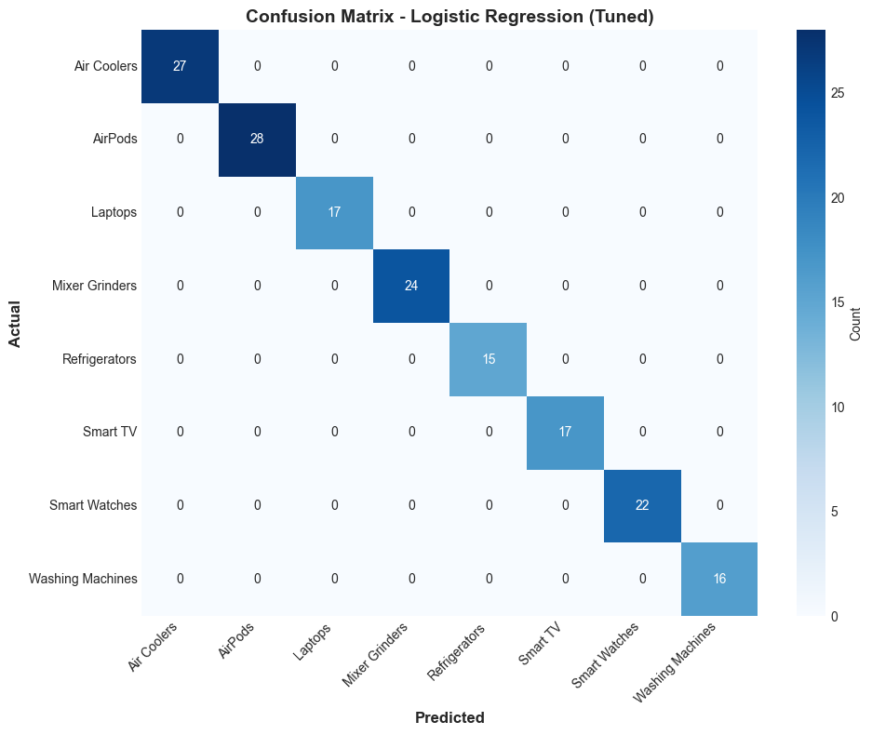
< Price Distribution
< Correlation Heatmap

Slide 9
Data Storage
  A relational database was created using SQLAlchemy
  Cleaned data was stored in structured tables
  Enabled efficient querying and reuse of data for modeling

Slide 10
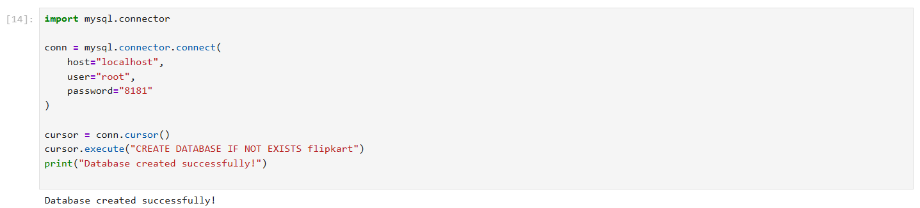
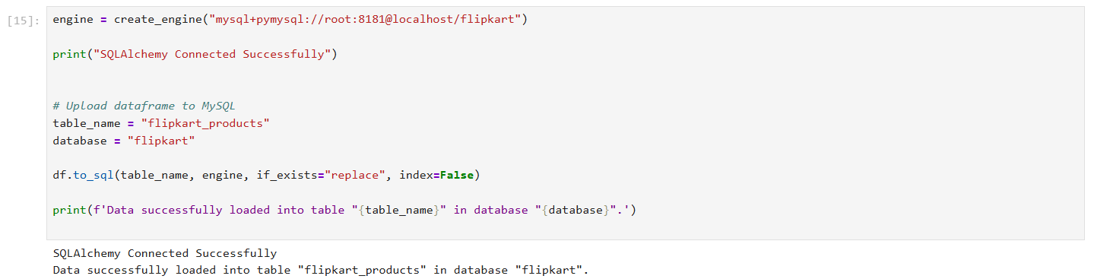

Slide 11
Unsupervised Learning (Clustering)
Technique Used
  K-Means Clustering
Process
  Selected relevant numerical features
  Tested multiple cluster values using the Elbow Method
  Assigned cluster labels to each product
Outcome
  Grouped similar products based on price, ratings, and reviews
  Helped identify premium, mid-range, and budget product clusters

Slide 12
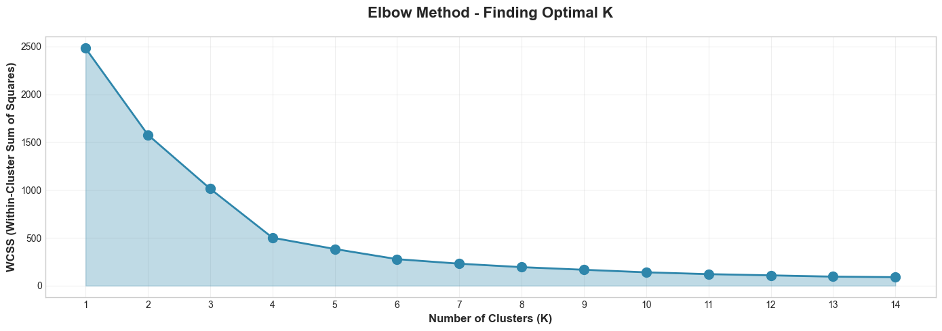
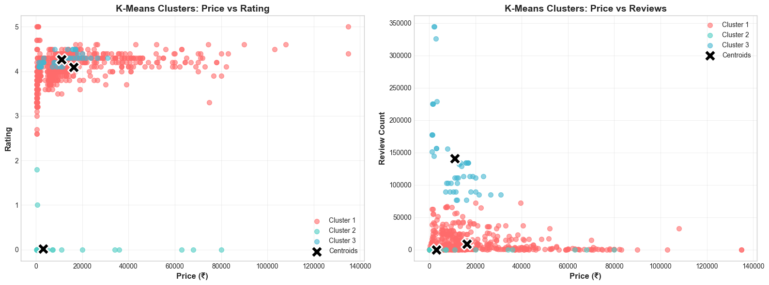
Elbow Method
K- Means Clusters

Slide 13
Multiple classification models were implemented to predict product categories or labels.
Models Used
    Logistic Regression
    Support Vector Machine (SVM)
    k-Nearest Neighbors (k-NN)
    Random Forest
    XGBoost
Supervised Learning

Slide 14
Thank You !

